Slide 1
EMAIL OPEN RATE PREDICTION - USING MACHINE LEARNING

Slide 2
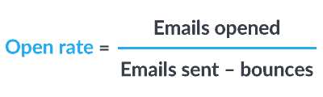
INTRODUCTION
A good email open rate should be between 17-28%, depending on the industry you're in.
While knowing these numbers is a great starting point,
it's worth it to look into your specific industry averages and compare your metrics with those in your specific industry

Slide 3
MAIN OBJECTIVES
● Used for various business compaigns and other concerns
● The main objective is to create a machine learning model to characterize the mail and track the mail that is ignored; read; acknowledged by the reader.
● In addition to the ML Model prediction, we also analyzed what all features can help us in getting the Email status to be not ignored by the customers

Slide 4
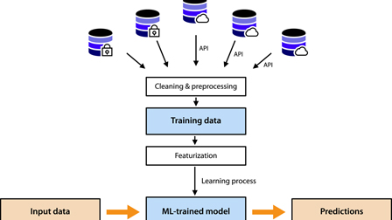
METHODOLOGY
A Machine Learning Methodology for Better Email Marketing CampaignsSo how do you build a machine learning algorithm to improve email marketing? There are probably many ways, but in broad strokes I’m going to explain my methodology.

Slide 5

MACHINE LEARNING MODEL
Decision Trees Regressor: Decision Trees are a non-parametric supervised learning method used for classification and regression. Decision Trees can perform multi-class classification on a dataset.
RandomforestRegressor : they are an ensemble Supervised Learning algorithm built on Decision trees. Random Forests are used for regression and classification tasks. The algorithm takes its name from the random selection of features.
The goal of my model was to predict how well an email would perform based solely on subject lines. Many email clients already use Naïve Bayes algorithms

Slide 6
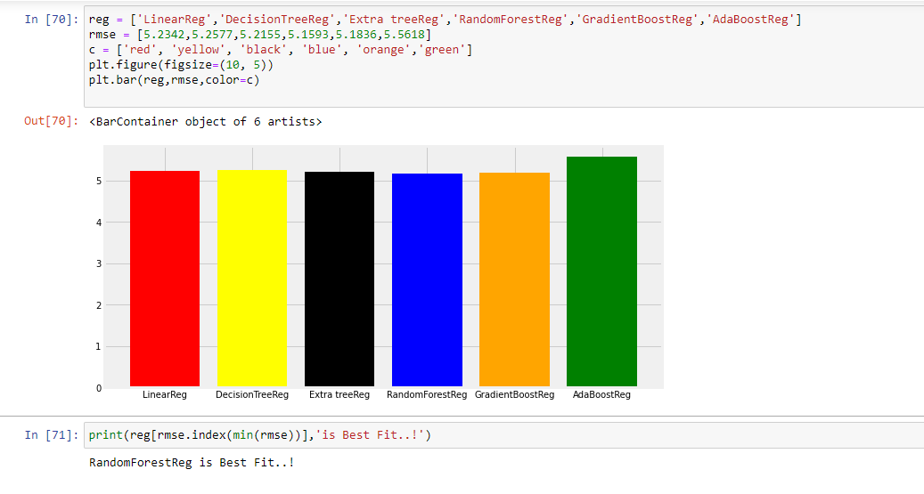
VISUALIZATION OF MODEL FITTING

Slide 7
CHALLENGES
● Choosing the appropriate technique to handle the imbalance in data was quite challenging as it was a tradeoff b/w information loss vs risk of overfitting.
● Overfitting was another major challenge during the modelling process.
● Understanding what features are most important and what features to avoidwas a difficult task.
● Decision making on missing value imputations and outlier treatment wasquite challenging as well.

Slide 8
CONCLUSION
The ratio of the Email_Statuswas the same irrespective of the demographic location or the time frame theemails were sent on.
(i) Use 6 to 10 words in your subject lines to get the best open rate.
(ii) Personalize subject lines with the reader's name.
(iii)Use a recognizable sender name.
(iv) Optimize your email campaigns for mobile .

Slide 9
WEB REFERENCES
[1] Douglas Aberdeen, Ondrej Pacovsky, and Andrew Slater. 2010. The learning behind gmail priority inbox. In LCCC: NIPS 2010 Workshop on Learning on Cores, Clusters and Clouds.
[2] Raju Balakrishnan and Rajesh Parekh. 2014. Learning to predict subject-line opens for large-scale email marketing. In Big Data (Big Data), 2014 IEEE International Conference on. IEEE, 579–584.
[3] https://github.com/shishir349/Analyzing-the-Email-Opening-Rates.
[4] http://wwbp.org/papers/Jaidka_email_article_clickthroughs.pdf

Slide 10
THANKYOU….!

